Slide 1
Functional Dependency (FD) is a constraint that determines the relation of one attribute to another attribute in a Database Management System (DBMS).
Functional Dependency helps to maintain the quality of data in the database.
It plays a vital role to find the difference between good and bad database design.
A functional dependency is denoted by an arrow “→”.
The functional dependency of X on Y is represented by X → Y.

Slide 2
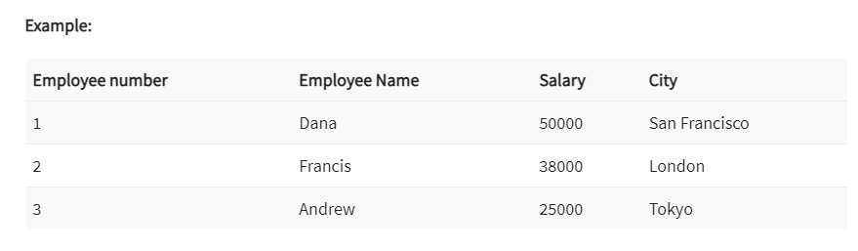
Employee number, we can obtain Employee Name, city, salary, etc.
By this, we can say that the city, Employee Name, and salary are functionally depended on Employee number.

Slide 3
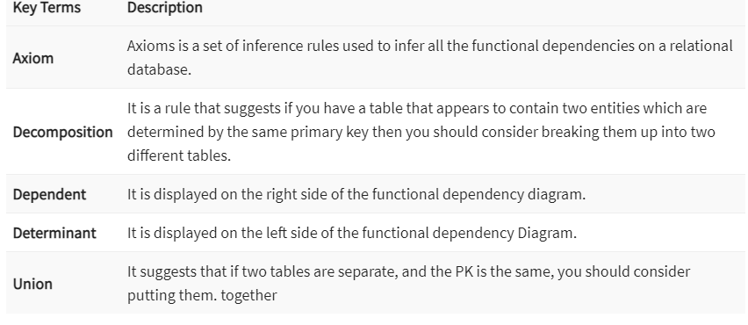

Slide 4
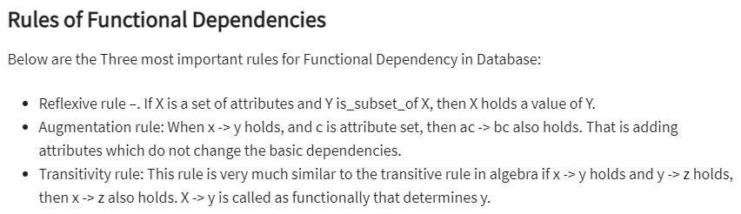

Slide 5
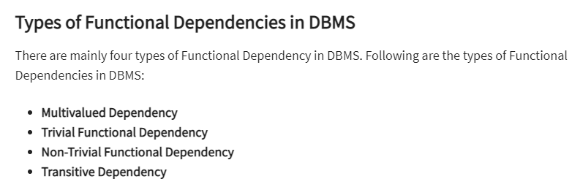

Slide 6
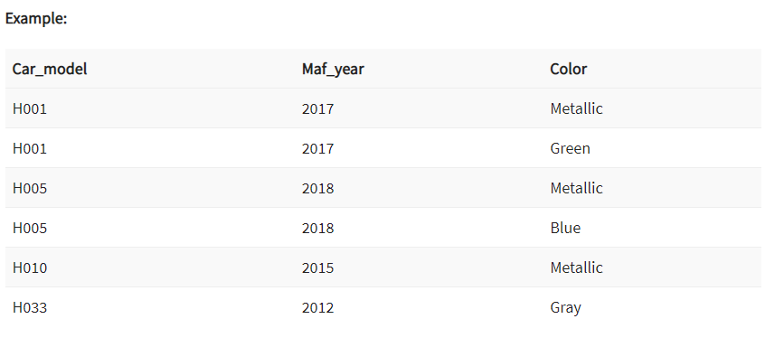
Independent of each other
Dependent
This dependence can be represented like this:
car_model -> maf_year
car_model-> colour

Slide 7
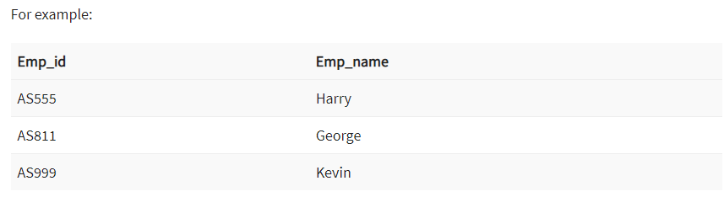
Trivial Functional Dependency in DBMS
The Trivial dependency is a set of attributes which are called a trivial if the set of attributes are included in that attribute.
So, X -> Y is a trivial functional dependency if Y is a subset of X.
Consider this table of with two columns Emp_id and Emp_name.
{Emp_id, Emp_name} -> Emp_id is a trivial functional dependency as Emp_id is a subset of {Emp_id,Emp_name}.

Slide 8
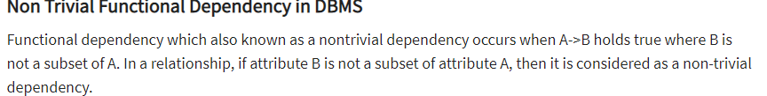
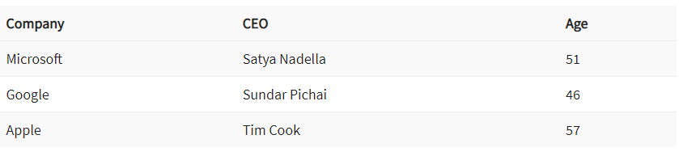
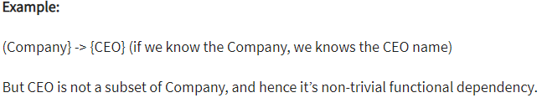

Slide 9
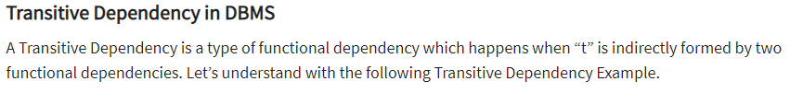
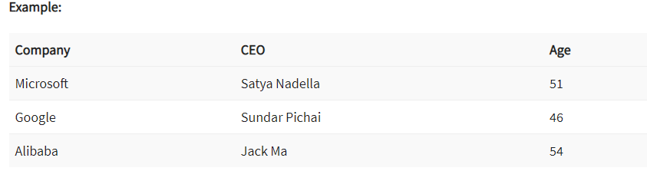
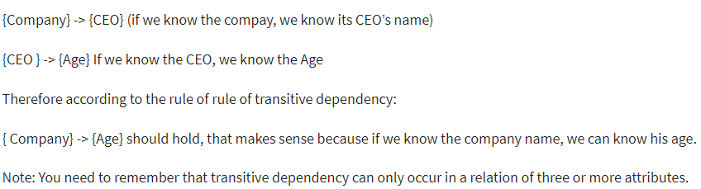

Slide 10
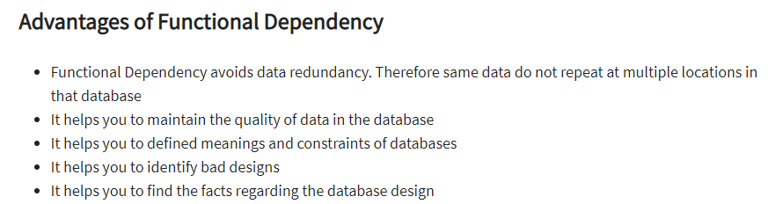

Slide 11
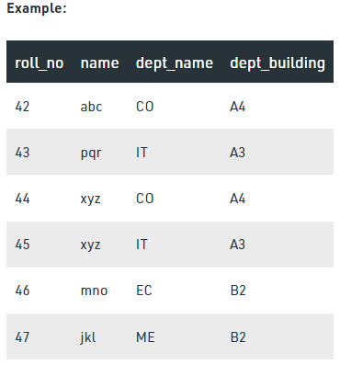

Slide 12
From the above table we can conclude some valid functional dependencies:
roll_no → { name, dept_name, dept_building },→ Here, roll_no can determine values of fields name, dept_name and dept_building, hence a valid Functional dependency
roll_no → dept_name , Since, roll_no can determine whole set of {name, dept_name, dept_building}, it can determine its subset dept_name also.
dept_name → dept_building , Dept_name can identify the dept_building accurately, since departments with different dept_name will also have a different dept_building
More valid functional dependencies: roll_no → name, {roll_no, name} ⇢ {dept_name, dept_building}, etc.

Slide 13
Here are some invalid functional dependencies:
name → dept_name Students with the same name can have different dept_name, hence this is not a valid functional dependency.
dept_building → dept_name There can be multiple departments in the same building,
For example, in the above table departments ME and EC are in the same building B2, hence dept_building → dept_name is an invalid functional dependency.
More invalid functional dependencies: name → roll_no, {name, dept_name} → roll_no, dept_building → roll_no, etc.

Slide 14
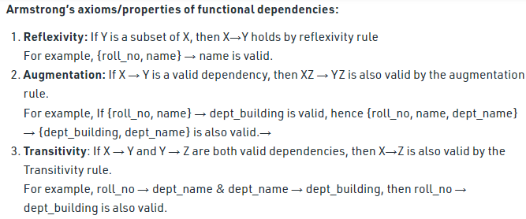

Slide 15
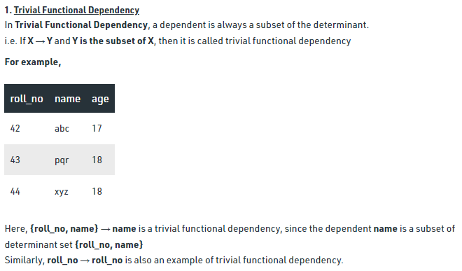

Slide 16
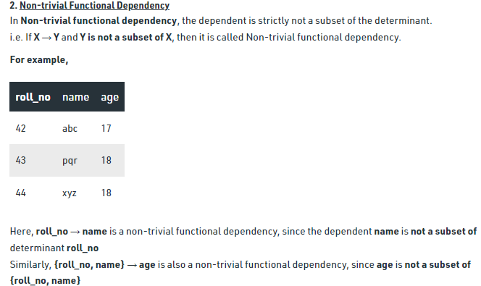

Slide 17
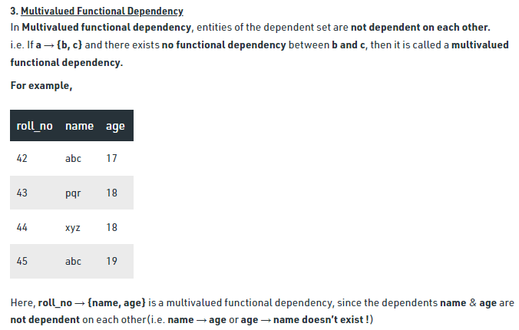

Slide 18
